Slide 1
Happy diary

Slide 2
TACKLING ISSUES
Mental health problem
People with mental health problem
Pretend to be optimistic in public (social networks, friends)
Not realizing how serious their problems are
Need private and safe environment talk about their concerns and problems

Slide 3
WHY HAPPY DIARY
Light weight, personalized
Keywords, segment ideas
Private, safe
User friendly
Easy to use UI
User interaction (tips, suggestions)
Cross-platform desktop app

Slide 4
TECH
Microsoft Cognitive Services (Text Analytics API)
Firebase (backend database)
React, Electrons (frontend)

Slide 5
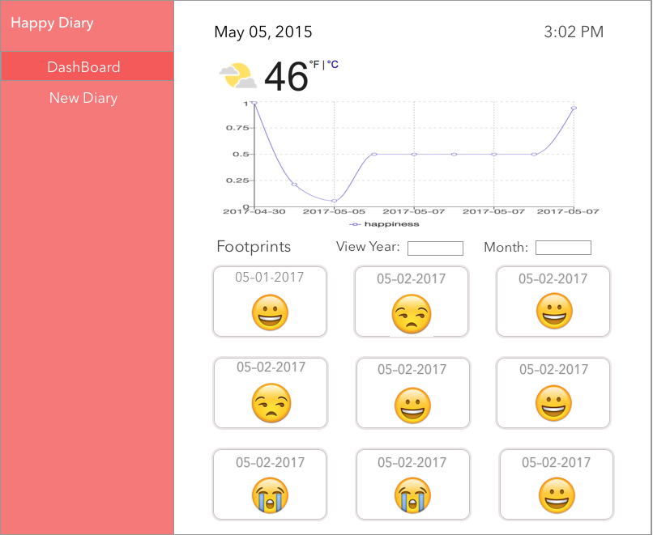
PROTOTYPE

Slide 6
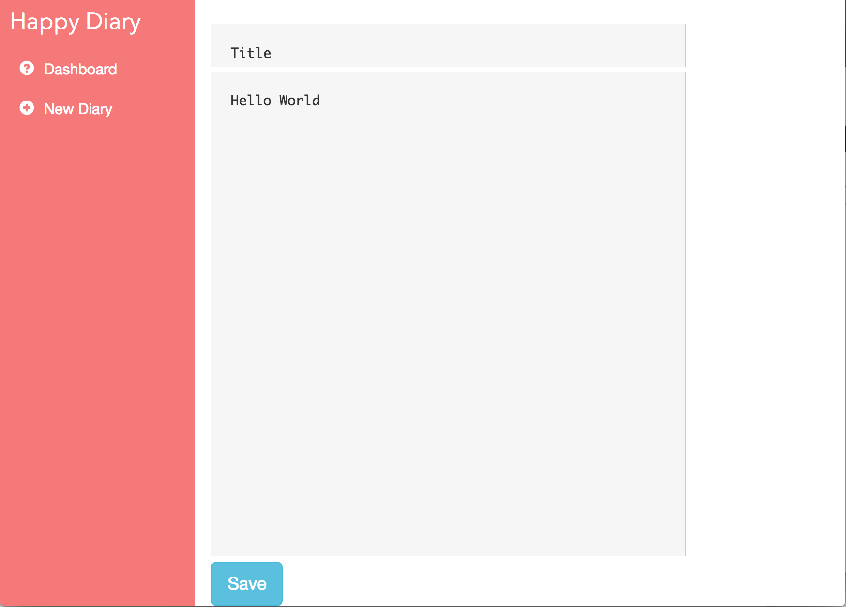
PROTOTYPE

Slide 7
LIVE DEMO

Slide 8
Q&A

Slide 9
THANK YOU !

